Slide 1
Lowland WA lakes food webs
Touch base with Julian
5/13/2021

Slide 2
Data set overview
27 different lakes
9 have > 1 sampling event (Pine = 6, Wilderness = 3)
Excluding Pine 2013, there are 40 unique lake_year events.

Slide 3
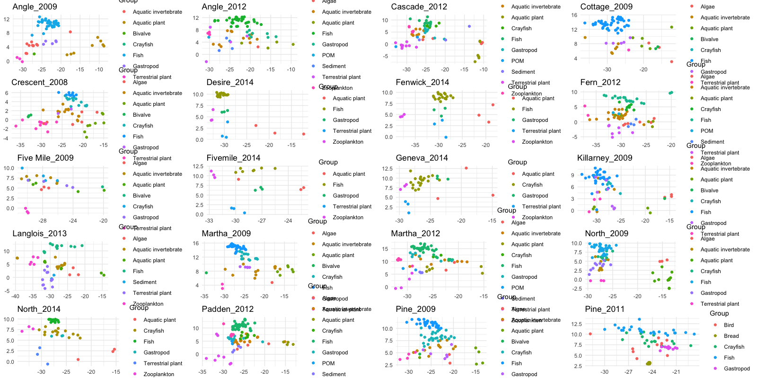

Slide 4
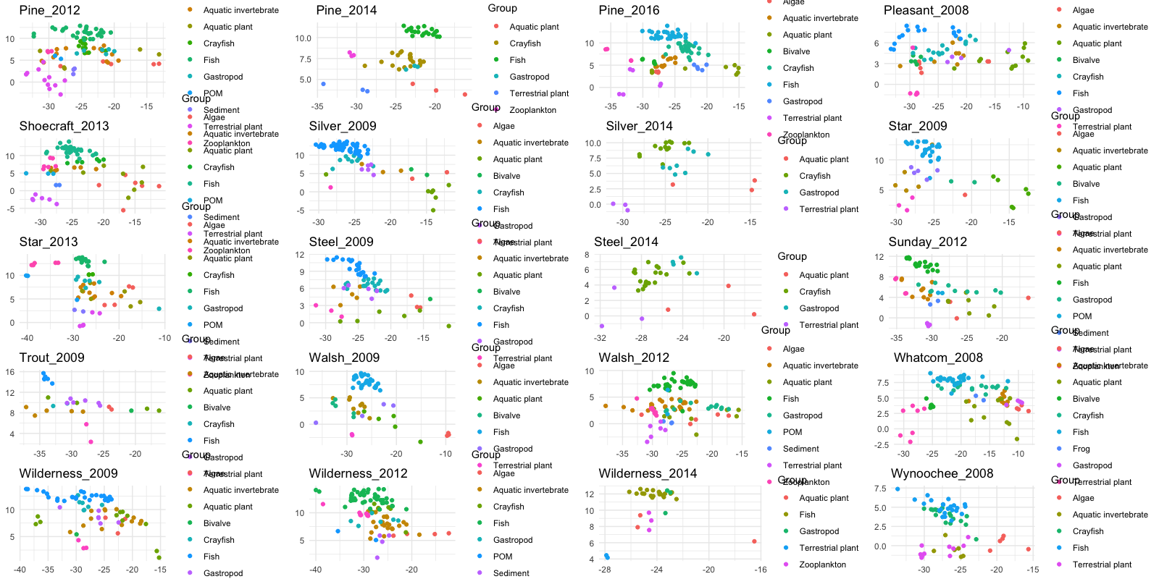

Slide 5
Pumpkinseed (Lepomis gibbosus) was the most commonly captured species
Lepomis gibbosus | 24
Micropterus salmoides | 22
Perca flavescens | 22
Oncorhynchus mykiss | 18
Cottidae | 14
Ambloplites rupestris | 5
Ameiurus nebulosus | 5
Micropterus salmoides juv | 3
Oncorhynchus clarkii | 3
Oncorhynchus nerka | 3
Pomoxis nigromaculatus | 2
Ptychocheilus oregonensis | 2
Lepomis cyanellus | 1
Lepomis macrochirus | 1
Micropterus dolomieu | 1
Micropterus salmoides adu | 1

Slide 6
Can I do a mixing model to ID pumpkin seed invertebrate diet? Short answer is no.
But I can test trends of pumpkin seed relative to resources
I can examine littoral vs pelagic
I can do three source mixing models for this species and compare.

Slide 7
